Slide 1
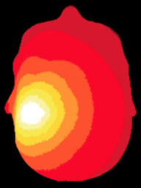
NeuroDOT
Tutorial:
Generating a Light Model
32x32 Full Head Pad

Slide 2
NeuroDOT Set-Up - Checklist
Before starting any tutorial, please make sure you’ve done the following
Download the appropriate versions of matlab, neuroDOT, and NIRFAST
Matlab: 2020b
NeuroDOT toolbox from NITRC
https://www.nitrc.org/projects/neurodot/
NIRFASTer-master
https://github.com/nirfaster/NIRFASTer
Set your path so that all required folders and subfolders are included
Folders w/subfolders to include
NeuroDOT toolbox
NIRFASTer-master
Your personal directory
Folders to include
Output directory

Slide 3
NeuroDOT Set-Up – Output Directory
Example output directory
Once you’ve set your path, the next thing you should do is set your output directory.
The output directory must be located within your path
If it isn’t already in your path, you must add it to your path
You can set your own path to an output directory in the line shown above
An output directory specifies the location where files will be saved
MATLAB, by default, will save files to the current directory
The following line of code will change your current directory to the output directory that you just specified →
Now you can save outputs directly to your output directory

Slide 4

Diffuse Optical Tomography
In diffuse optical tomography (DOT), arrays of optical sources and detectors are used to perform functional neuroimaging experiments on task-based or resting state modes of human brain function.
Analyses are broken into several pipelines:
B: modeling of the tissue shape, optical property distribution, and source/detector locations
C: modeling of the light emission, diffusion, and detection through the head
D: preprocessing of the raw source-detector measurements
E: reconstruction and spectroscopy of the preprocessed data and light model into a functional neuroimaging volume
F: post-processing analysis of these results.

Slide 5
Generating a Light Model
This tutorial will follow the Basic_Light_Modeling_with_sparse_Pad_and_AlignMe_Tutorial_221026.m Matlab file which can be found in the Documentation/Scripts folder.
The tutorial will:
Generate a mesh from a segmented volume
Place an array of sources and detectors on the mesh
Set multiple parameters for the model
Calculate the sensitivity A for this model
We will use a segmented volume, Segmented_MNI152nl_on_MNI111_nifti, found in Support_Files/Atlases, to generate the head model.
We will use the visual pad, Pad_AdultV24x28.mat, found in Support_Files/Pad.

Slide 6
NeuroDOT Flowchart for Light Model Generation
MRI Acquisition
Image Segmentation
Mesh Generation
These steps are repeated for a low-density and high-density mesh
Optode Placement
Calculate Sensitivity
Validate Sensitivity

Slide 7
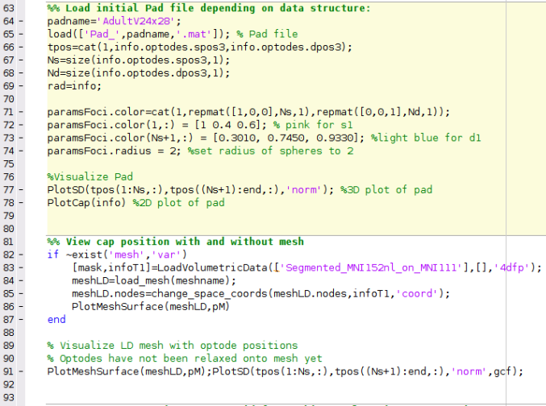
Running the script – Author’s Note
How the author runs the script
Highlight and execute each chunk of code
Ex: highlight lines 64-69 → right click → hit “Evaluate Selection”
Alternate way of running the script
For each section (beige) hit ctrl+enter
This isn’t how the author does it, but it will still work
Note: DO NOT HIT THE GREEN “RUN” BUTTON to run this script
MATLAB versions to use
Optimal version: MATLAB 2020b
The version that AlignMe was developed in
NIRFAST version to use
NIRFASTer, the newest release of NIRFAST
Found here: https://github.com/nirfaster/NIRFASTer
Example
section

Slide 8
NeuroDOT Set-Up – In Script
The first section of code in this script will add the required toolboxes to your path and allow you to navigate to your desired output directory from within the script
Some parameters for visualizations made in the script are set up here as well
%Set Output Directory
%Change the path on the following line to whatever output directory you want to use
outputdir = ‘’; % put path to directory in between quotes
cd(outputdir)
% Does your pad have shorter 2D positions for visualizing the pad in 2D?
% i.e. does your pad have optode positions in an EEG style?
% if 2D positions are shorter, set style = 1. Otherwise, set style = 0
style = 1; %for this tutorial, style should be set to 1
%Parameter Initialization
p.Cmap='jet'; p.Scale=5; p.Th.P=0; p.Th.N=-p.Th.P; p.PD=1; p.BG=[0,0,0];
pM.orientation='coord'; pM.Cmap.P='gray'; pM.EdgeColor='none';
pS = pM; pS = rmfield(pS, 'orientation'); % make copy of params, to be used with PlotSlices

Slide 9
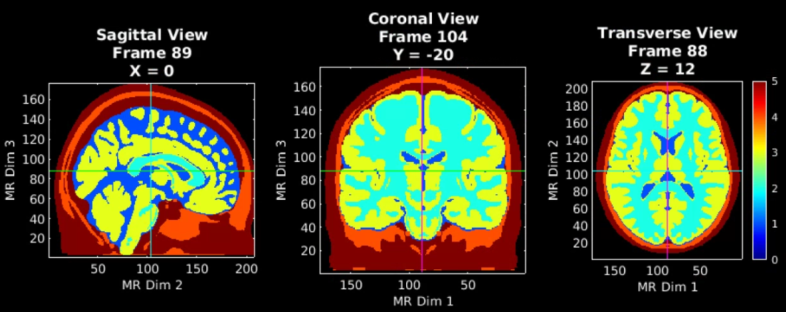
Load a Segmented volume and visualize
MRI Acquisition
Image Segmentation
[mask,infoT1]=LoadVolumetricData(['Segmented_MNI152nl_on_MNI111_nifti'],[],‘nii');
p.Cmap='jet';p.Scale=5;p.Th.P=0;p.Th.N=-p.Th.P;p.PD=1;p.BG=[0,0,0];
PlotSlices(mask,infoT1,p) % Visualize the segmented mask
Note that PlotSlices.m generates an interactive visualization of the volume. Simply press ‘q’ or the middle mouse button to release the figure.
5 – Scalp
4 – Skull
3 – Gray Matter
2 – White Matter
1 – CSF
0 - Background

Slide 10
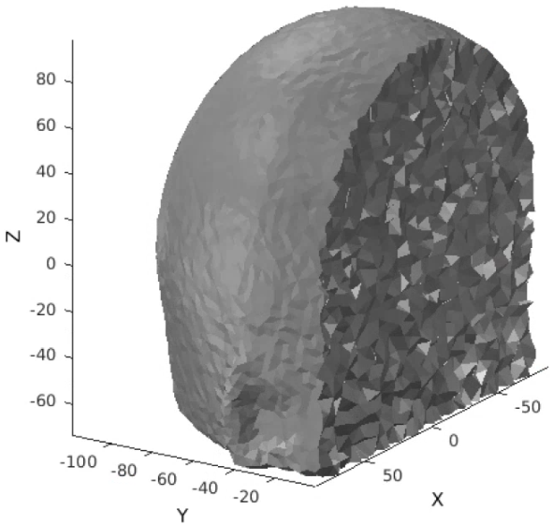
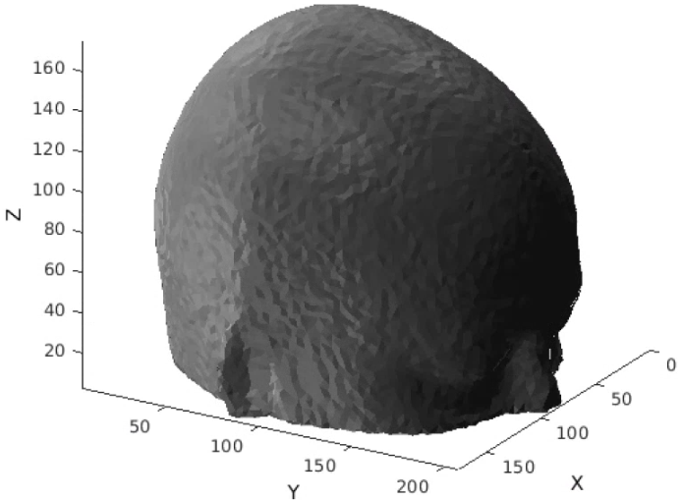
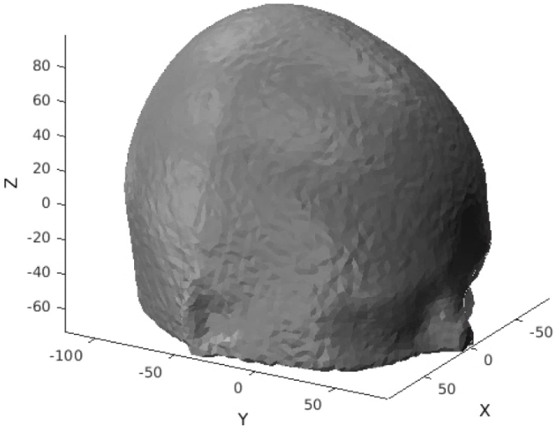
Generate a low-density mesh and visualize
MRI Acquisition
The low-density mesh will be used to efficiently align the optical array to its position on the head.
% Parameters for generating your mesh
meshname=[‘LD_Mesh']; % Provide a name for your mesh name here
param.facet_distance=5; % Node position error tolerance at boundary
param.facet_size=3; % boundary element size parameter
param.cell_size=5; % Volume element size parameter
param.info=infoT1;
param.Offset=[0,0,0];
param.r0=5; % nodes outside of mask must be set to scalp==5;
param.CheckMeshQuality=0;
param.Mode=1; % make simple mesh with no region labels
tic;meshLD=NirfastMesh_Region(mask,meshname,param);toc
PlotMeshSurface(meshLD,pM) %visualize in index (non-negative) space
view([135,30])
meshLD.nodes=change_space_coords(meshLD.nodes,infoT1,'coord');
PlotMeshSurface(meshLD,pM) %visualize in coordinate space
view([135,30])
% Look at the inside
m1.nodes=meshLD.nodes;m1.elements=meshLD.elements;
m2=CutMesh(m1,find(m1.nodes(:,2)>0)); %cut LD mesh in half
[Ia,Ib]=ismember(m2.nodes,mesh.nodes,'rows');Ib(Ib==0)=[];
PlotMeshSurface(m2,pM); %visualize back half of LD mesh
view([135,30])
Image Segmentation
LD Mesh Generation
A view inside
“index space”
is non-negative
“coordinate space”
Usually has zeros in center of volume

Slide 11
Atlas vs Subject Specific LD Mesh Generation
MRI Acquisition
Depending on your starting volume, the low-density mesh generation process will differ
Atlas based mesh (what this tutorial does)
Set param.Offset = [0,0,0];
Then use change_space_coordinates()
Subject specific based mesh
Set param.Offset = InfoT1.center; (that’s it)
% Parameters for generating your mesh
meshname=[‘LD_Mesh']; % Provide a name for your mesh name here
param.facet_distance=5; % Node position error tolerance at boundary
param.facet_size=3; % boundary element size parameter
param.cell_size=5; % Volume element size parameter
param.info=infoT1;
param.Offset=[0,0,0];
param.r0=5;
param.CheckMeshQuality=0;
param.Mode=1;
tic;meshLD=NirfastMesh_Region(mask,meshname,param);toc
meshLD.nodes=change_space_coords(meshLD.nodes,infoT1,'coord’);
Image Segmentation
LD Mesh Generation
“coordinate space”
Usually has zeros in center of volume
“index space”
is non-negative

Slide 12
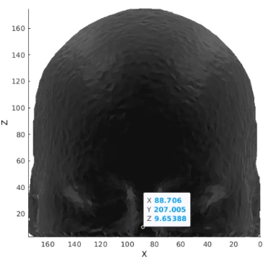
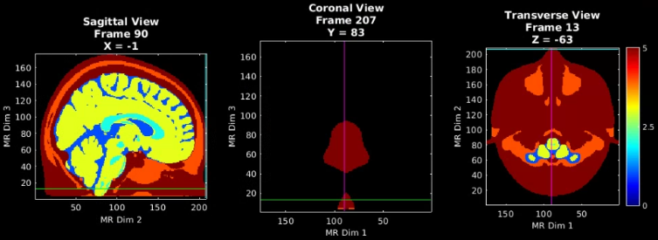
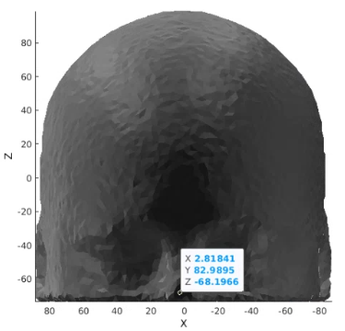
Validating LD Mesh Generation
MRI Acquisition
Make sure your mesh is in the same space as your volume
In PlotSlices, place crosshairs at the tip of the nose
Note the X, Y, and Z coordinates for those slices
Generate LD mesh with your chosen parameters
Param.Offset = [0,0,0]; or Param.Offset = infoT1;
Use change_space_coordinates() or don’t use it
In atlas figure, click on the tip of the nose of the mesh
Note the X, Y, and Z coordinates for those slices
Repeat the above 2 steps, with different parameters if the X, Y, Z coordinates are not similar
Image Segmentation
LD Mesh Generation
Atlas Volume
+
No CSC
Volume coords
X = -1
Y = 83
Z = -63
Atlas Volume
+
CSC
Coords are similar to volume!

Slide 13
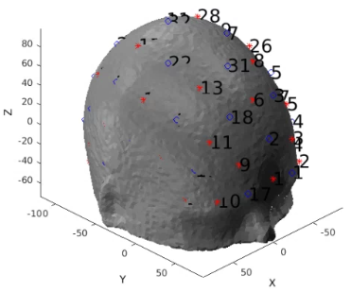
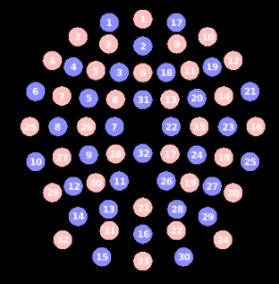
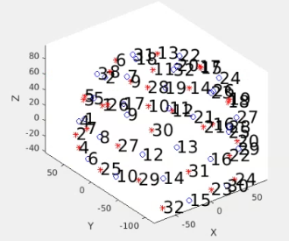
Place the optodes on the LD mesh
MRI Acquisition
Load in a Pad file for a grid design of interest, here we use the AdultV24x28 array.
padname='FullHead_32x32';
load(['Pad_',padname,'.mat']); % Pad file
% If optode positions are in EEG style, then for visualization purposes,
% 2D positions are smaller than they should be
if style == 1
info.pairs.r2d = info.pairs.r3d; %set 2d distances to 3d distances
end
tpos=cat(1,info.optodes.spos3,info.optodes.dpos3);
Ns=size(info.optodes.spos3,1);
Nd=size(info.optodes.dpos3,1);
rad=info;
paramsFoci.color=cat(1,repmat([1,0,0],Ns,1),repmat([0,0,1],Nd,1));
paramsFoci.color(1,:) = [1 0.4 0.6]; %pink for s1
paramsFoci.color(Ns+1,:) = [0.3010, 0.7450, 0.9330]; %light blue for d1
paramsFoci.radius = 2; %set radius of spheres to 2
Draw_Foci_191203(tpos, paramsFoci);view([-40,30]) %3D plot of pad
params_cap.eeg_style = 1; %turn on EEG style for this cap
PlotCap(info, params_cap)
PlotMeshSurface(meshLD,pM);Draw_Foci_191203(tpos, paramsFoci);view([135,30])
Note: This Pad file is a starting point and may not align with the mesh right away.
Image Segmentation
LD Mesh Generation
Optode Placement
2D positions
3D positions

Slide 14
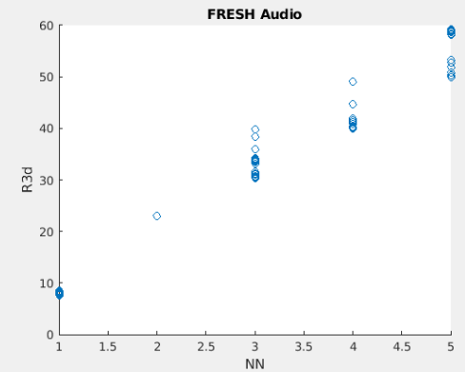
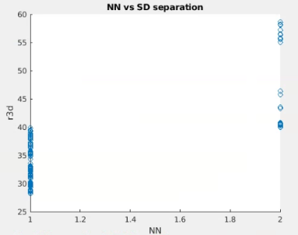
Check Optode Separation against Nearest Neighbors
MRI Acquisition
Nearest Neighbor vs Optode Separation scatterplot is a useful tool for catching potential issues for spring relaxation before they occur.
First, make sure only meas < 6cm are included in the scatterplot
Then visualize info.pairs.NN agains info.pairs.r3d.
%% Make sure only NN1 and NN2 exist for meas < 6cm
% If optode positions are in EEG style, then for visualization purposes,
% 2D positions are smaller than they should be
% Visualize scatterplot of Nearest neighbors for all measurements under 6cm
keep = info.pairs.r3d < 60; %Set cutoff at 6cm (60mm), we won't use any measurements larger than this
figure;
scatter(info.pairs.NN(keep),info.pairs.r3d(keep));
xlabel('NN');ylabel('r3d');title('NN vs SD separation’);
If the plot contains NN3, NN4, etc. Correct the info structure so that measurements < 6cm have only NN1 and NN2
% If the plot shows measurements for NN3 or greater, run the following lines (See slide 12 of tutorial powerpoint)
info.pairs.NN(info.pairs.r3d < 30) = 1; %Set all meas with separation < 3cm to NN1
info.pairs.NN(info.pairs.r3d >= 30 & info.pairs.r3d < 60) = 2; %Set all meas in between 3cm and 6cm separation to NN2
figure; %Re-visualize
scatter(info.pairs.NN(keep),info.pairs.r3d(keep));
xlabel('NN');ylabel('r3d');title('NN vs SD separation');
Image Segmentation
LD Mesh Generation
Optode Placement
Before correction
After Correction
See, there are measurements for NN3, 4, and 5. This is what we want to correct
Now, only NN1 and NN2 remain
Note: The “before correction” plot is not generated in the MATLAB tutorial script

Slide 15
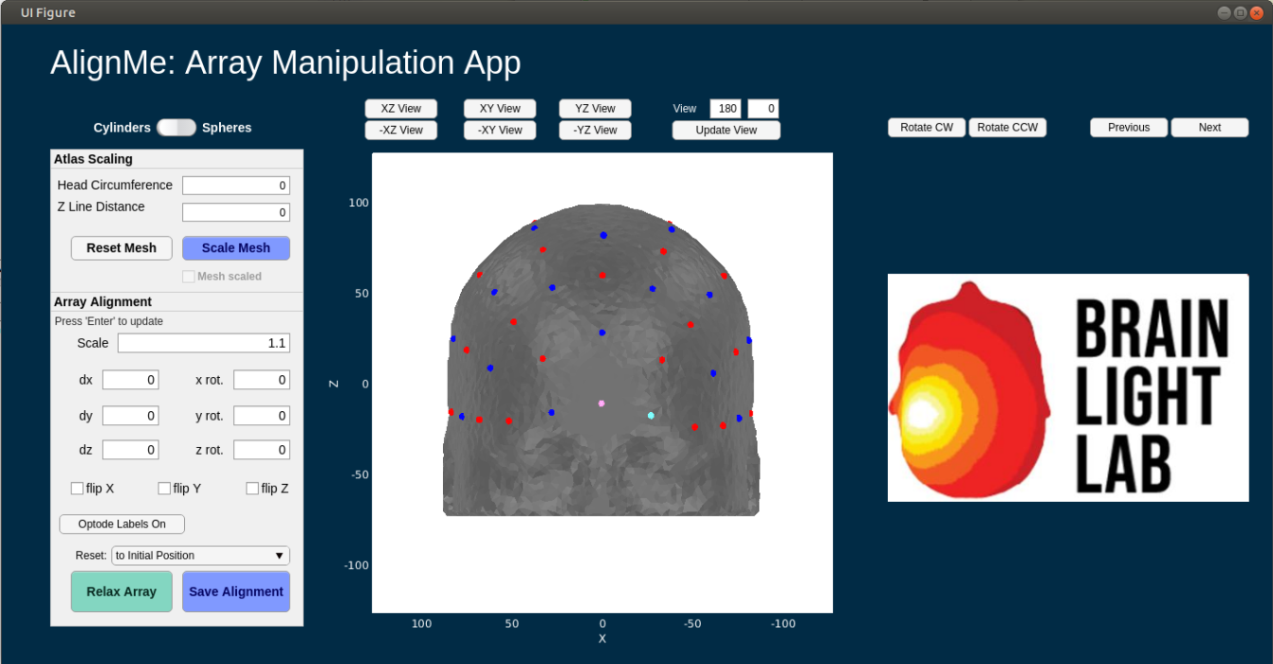
AlignMe Functionality
AlignMe allows for the user to scale the mesh to participant specific space by using
Participant Head Circumference
Participant Z line distance (nasion to inion)
These are contained within the Atlas Scaling box
Additionally, to facilitate easier alignment for participant specific situations, photos of the capfit can be utilized, and will show up where the Brain Light Lab logo is located on the GUI
Rotate CW, Rotate CCW: rotates photo
Previous, Next: scroll through available photos
Participant photos can be loaded in by setting the path to the directory containing photos. AlignMe will pull all files of the designated image type
Path to photos: ds.dI.photopath
Type of image: ds.dI.imageType
Note: The following 11 slides are an in-depth tutorial on how to use the AlignMe app
The mesh will not be scaled in this tutorial
There will not be any participant photos in this tutorial
You can find a standalone tutorial for using AlignMe in a matlab script titled: AlignMe_Standalone_Tutorial.m
Tutorial can be found in the Documentation/Scripts folder of the NeuroDOT toolbox
A powerpoint to go along with the script can be found in Documentation/Tutorials, it is titled: NeuroDOT_Tutorial_AlignMe.pptx

Slide 16
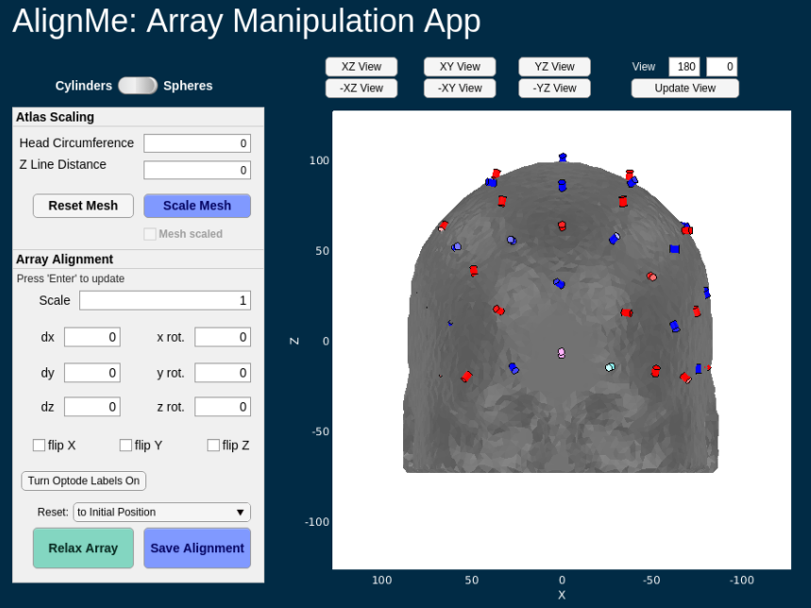
AlignMe Tutorial 1
% Create an instance of our custom DataStorage HANDLE class
ds = DataStorage();
% Input structure
ds.dI.tpos = tpos;
ds.dI.mesh = mesh;
ds.dI.pad = info;
ds.dI.pM = pM;
ds.dI.paramsFoci = paramsFoci;
ds.dI.Ns = Ns;
ds.dI.photoPath = ‘’;
ds.dI.imageType = '.jpeg';
ds.dI.atlasFiducials = atlasFiducials;
% Run AlignMe
myapp=AlignMe_2020b(ds);
while isvalid(myapp); pause(0.1); end
Default view on AlignMe launch

Slide 17
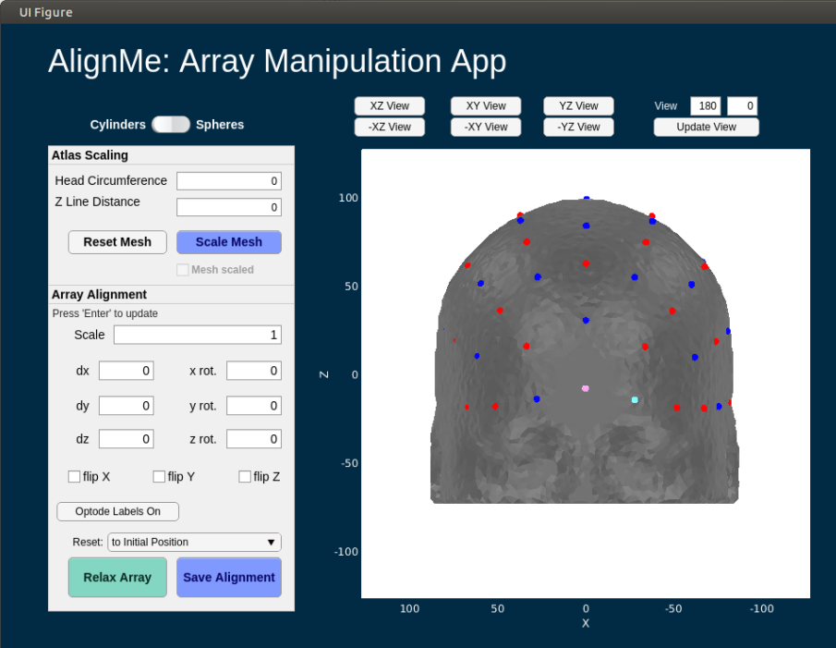
AlignMe Tutorial 2
First, lets switch to spherical optodes
Hit the switch above the “Atlas Scaling box”
There is a unique issue with running AlignMe on a LINUX device where you will be unable to change values in the edit fields on launch
This is due to a currently unresolved Matlab/Linux issue
To fix this, click on the “UI Figure” bar on the top of the app figure window
Default view on AlignMe launch

Slide 18
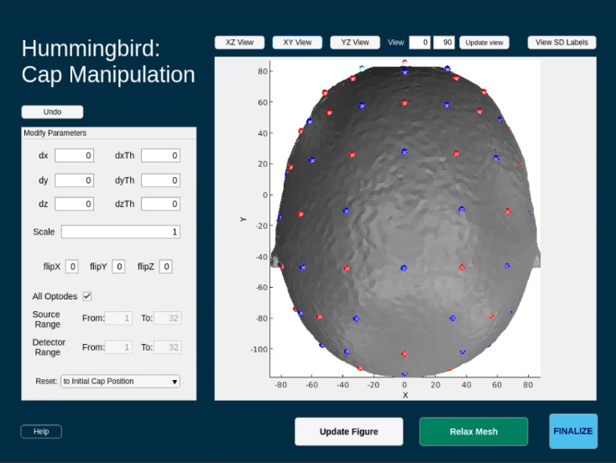
AlignMe Tutorial 3
Change the view to fully view the pad
The pad is the grid comprised of red and blue spheres; these denote optodes
Red = Source
Blue = Detector
Some optodes might start within the mesh
Switch to XY view to start

Slide 19
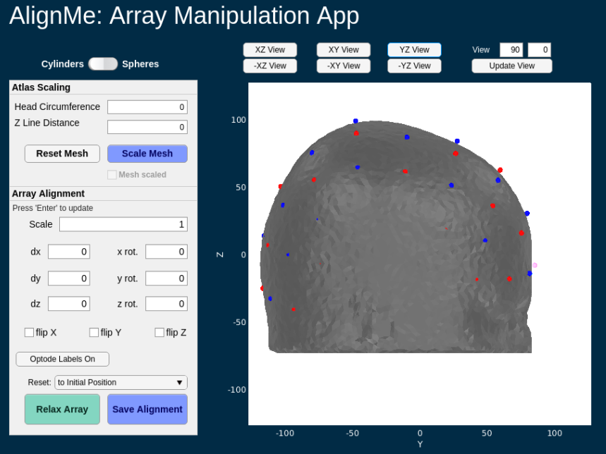
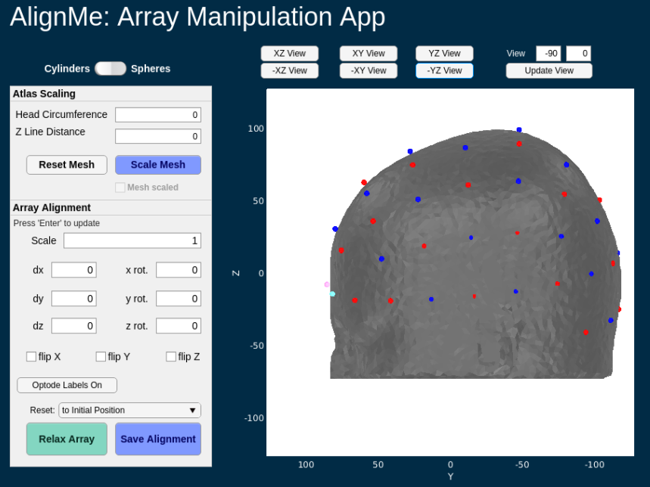
AlignMe Tutorial 4
Change the view to fully view the pad
The pad is the grid comprised of red and blue spheres; these denote optodes
Red = Source
Blue = Detector
Some optodes might start within the mesh
Now try YZ view
Note that some optodes aren’t visible right now because they’re inside the mesh
You can also manually set the view by editing the numbers
Set the first value to -90
Then hit “Update view”

Slide 20
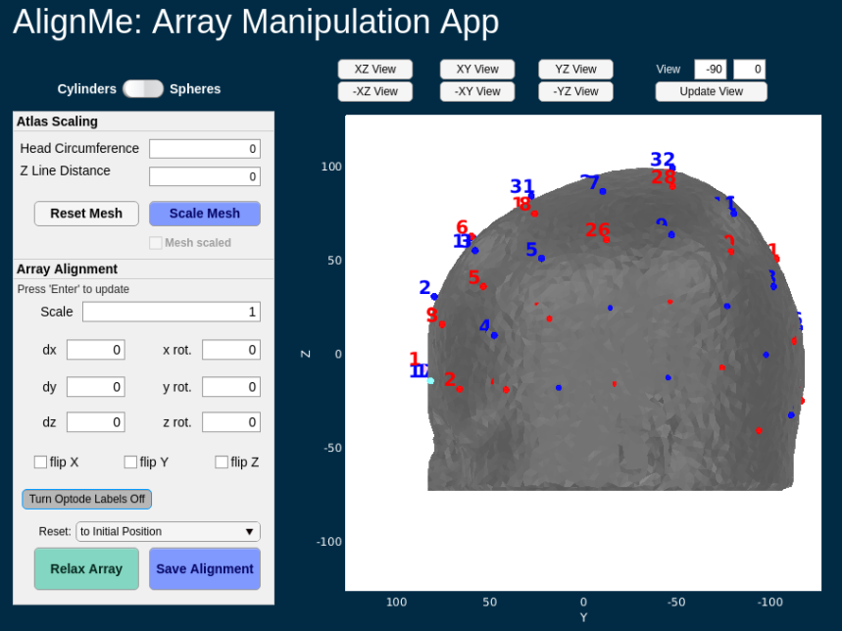
AlignMe Tutorial 5
You can also view source and detector (SD) numbers by hitting the “Turn Optode Labels On” button
If labels are off, button says
“Turn Optode Labels On”
If labels are on, button says
“Turn Optode Labels Off
Lets turn optode labels off for the rest of this tutorial

Slide 21
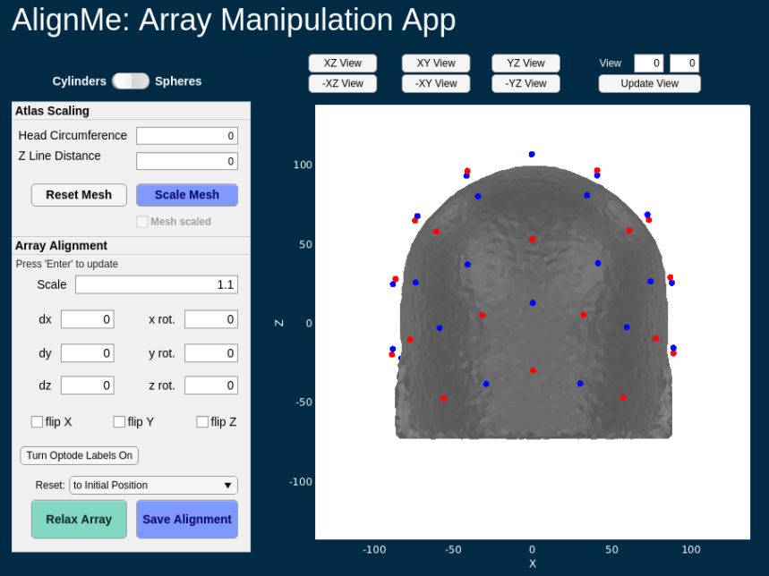
AlignMe Tutorial 6
Back to XZ view
Set scale to 1.1
Hit “enter”, “tab”, or simply click anywhere else on the app after changing an edit field and the app will automatically update
We want the optodes to be around 5-10mm AWAY from the head so that they can relax back on to it
Double check that all the optodes are away from the head by changing views

Slide 22
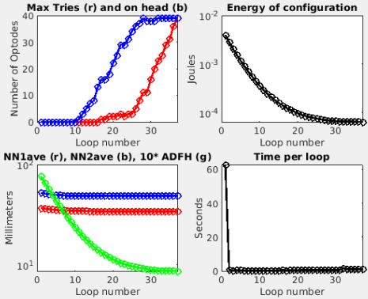
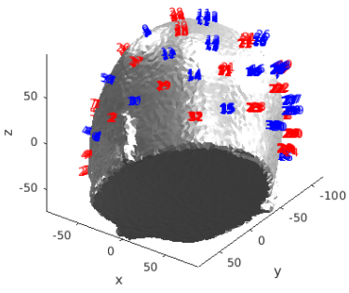
AlignMe Tutorial 7
Once you’ve verified that the pad position is correct and that optodes are away from the head, hit the “Relax Array” button
The below two figures will open and start to update
When relaxation is finished, the figures will look like below

Slide 23
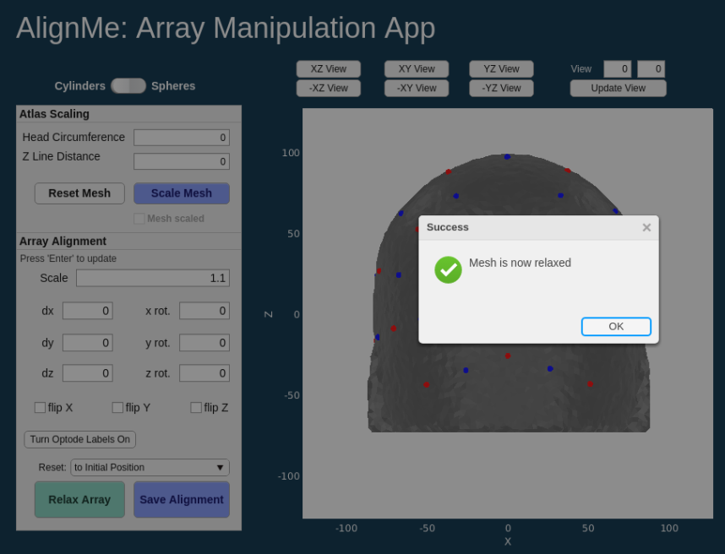
AlignMe Tutorial 8
Once optodes are relaxed onto the mesh, a dialogue box will show up on the AlignMe app
Hit “OK” to close it

Slide 24
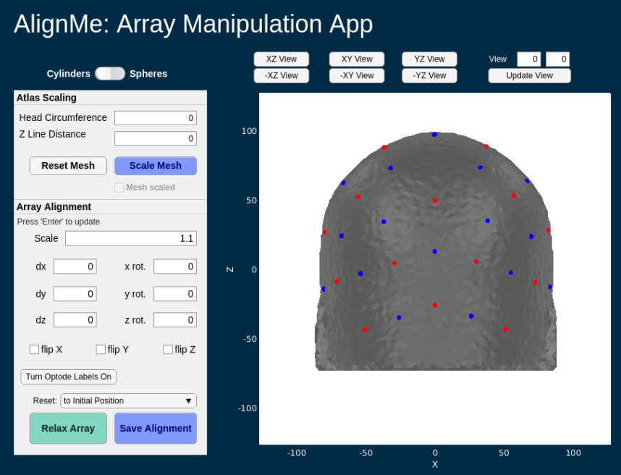
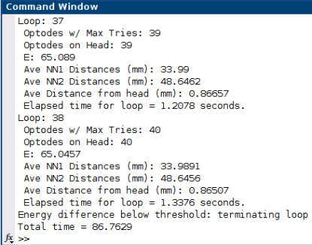
AlignMe Tutorial 9
To save the new optode locations to your MALTAB workspace, hit the “Save Alignment” button

Slide 25
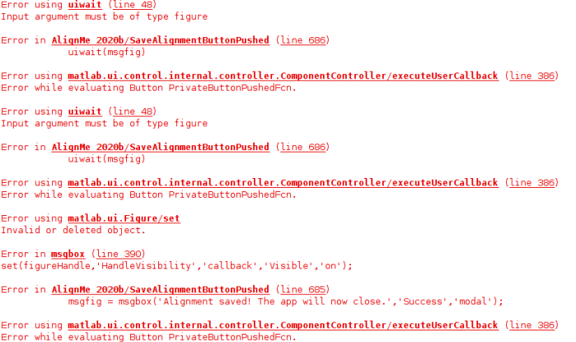
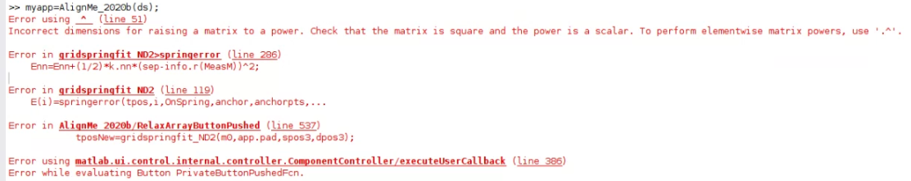
AlignMe Tutorial Potential Errors
Sometimes, when clicking the “Save Alignment” button, the error shown on the right occurs
Usually this is due to clicking the button multiple times before the app has finished running
To fix, just select 'Save Alignment' again
Make sure you only click once
Please be patient
See slide 12 for a fix to this error

Slide 26
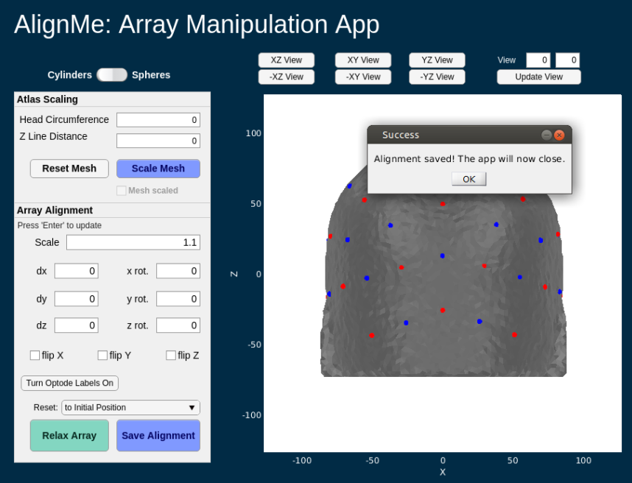
AlignMe Tutorial 10
A final dialogue box will open. Click OK to close AlignMe
You’ve finished the AlignMe tutorial!

Slide 27
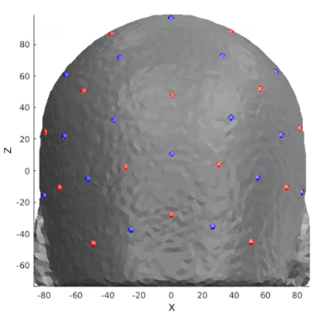
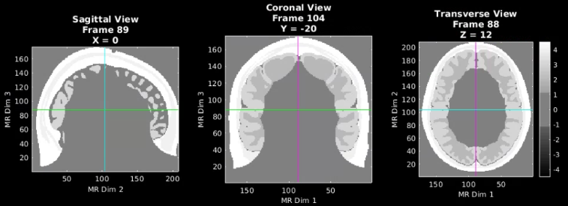
Generate smaller mask based on optode locations
MRI Acquisition
Here, we get our relaxed grid position and visualize it on the LD mesh. Then, we scoop out the part of the mesh that the grid is sitting on. This scooped section will is the basis for the high-density mesh that we are about to create
% get relaxed optode positions from Hummingbird
tposNew = ds.dO.tpos2_relaxed;
% visualize mesh with relaxed optodes
pM.reg=0;
PlotMeshSurface(meshLD,pM);Draw_Foci_191203(tposNew,paramsFoci)
view(0,0)
%% Generate smaller mask based on optode locations
maskCrop=IceCreamScoopCap4Mask(infoT1,tposNew,mask,40); %40 = mm of mesh to scoop out
PlotSlices(maskCrop,infoT1,pS) % visualize smaller mask
Image Segmentation
LD Mesh Generation
Optode Placement
HD Mesh Generation

Slide 28
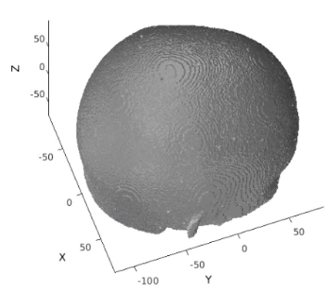
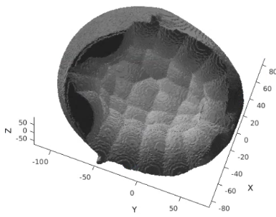
Generate a high-density mesh and visualize
MRI Acquisition
Take the scooped section of the LD mesh and turn it into a HD mesh
% If you get an error when running NirfastMesh_Region,
% try changing the mesh name and then re-run NirfastMesh_Region
meshname=['_HD_Mesh0']; % Provide a name for your mesh name here
param.facet_distance=2.0; % Node position error tolerance at boundary
param.facet_size=0.8; % boundary element size parameter
param.cell_size=1.5; % Volume element size parameter
param.Mode=0; % Set Mode=0 to make nirfast compliant mesh
tic;meshHD=NirfastMesh_Region(maskCrop,meshname,param);toc
%make copy of mesh that only contains nodes and elements for visualization purposes
visMeshHD.nodes = meshHD.nodes;
visMeshHD.elements = meshHD.elements;
% Put coordinates back in coordinate space meshHD.nodes=change_space_coords(meshHD.nodes,infoT1,'coord'); %for actual mesh visMeshHD.nodes=change_space_coords(visMeshHD.nodes,infoT1,'coord'); %for mesh that’s visualized PlotMeshSurface(visMeshHD,pM);view([70,60]) %Visualize in coordinate space
Image Segmentation
LD Mesh Generation
Optode Placement
HD Mesh Generation
Top View
Bottom View
Bottom view helps to make sure the mesh is totally hollow, with no connected strands on the inside

Slide 29
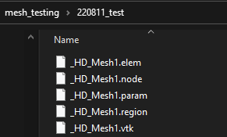
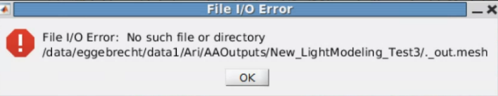
Generate a high-density mesh and visualize
Notes and possible errors
MRI Acquisition
Image Segmentation
Notes on HD mesh generation
Parameters
Facet_distance = error tolerance at boundary for node positions
Typically set to 2.0
Facet_size = size of surface triangles of mesh
Want to keep this as small as possible bc we want the surface to be highly faceted
Typically set to 0.8
Cell_size = size of internal tetrahedra
This can be changed depending on if the total number of nodes in the mesh is > 999,999
Typically set to 1.0, but in this tutorial set to 1.5
Possible Error
File I/O Error:
Solution: delete all mesh files in your output directory, change the meshname variable to a new name and re-run
Ex: ‘_HD_Mesh1’ → ‘_HD_Mesh0’
Make sure you delete these files from the file manager, and NOT within matlab
If the above doesn’t work, create an entirely new output directory, make that directory your current folder, then re-run lines 149-168
LD Mesh Generation
Optode Placement
HD Mesh Generation
Files to delete if File I/O Error occurs
Pop-up box for File I/O Error

Slide 30
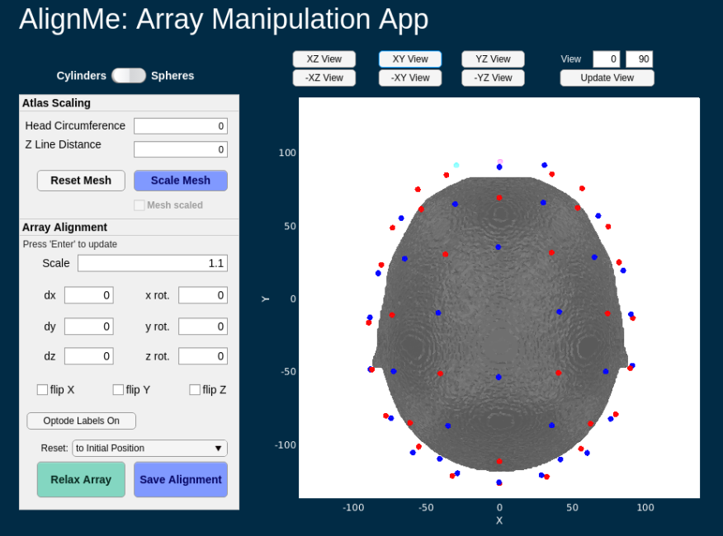
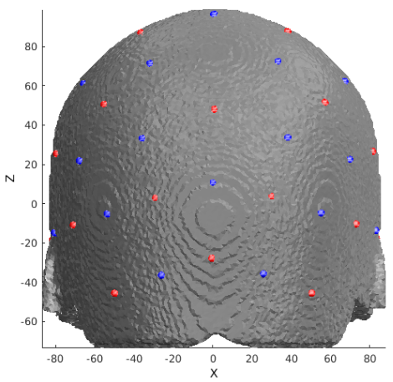
Place the optodes on the HD mesh
MRI Acquisition
This time, since the HD mesh is in the same space that the LD mesh was, the grid will already be lined up and sitting on the mesh when AlignMe starts. You’ll need to move it away from the mesh and re-relax the grid back onto the mesh
Scroll through all views of the mesh/pad and make sure no optodes are sitting inside the mesh
Switch from cylinders to spheres
Adjust the scale to 1.1 (this is the scale we used for the LD mesh too)
The AlignMe GUI should now look like the image below
Hit “Relax Mesh” and then “Save Alignment” after the grid has been re-relaxed onto the mesh
Image Segmentation
LD Mesh Generation
Optode Placement
% get relaxed optode positions from Hummingbird
% input structure
ds_HD = DataStorage();
ds_HD.dI.tpos = tposNew;
ds_HD.dI.mesh = visMeshHD;
ds_HD.dI.pM = pM;
ds_HD.dI.paramsFoci = paramsFoci;
ds_HD.dI.Ns = Ns;
ds_HD.dI.rad = rad;
% run hummingbird
myapp=Hummingbird(ds_HD);
while isvalid(myapp);pause(0.1);end
HD Mesh Generation
Optode Placement

Slide 31
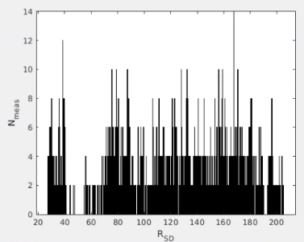
Update pad info structure after running Hummingbird
After the pad has been relaxed onto the HD mesh, we need to update the info structure with the new optode locations
info.optodes.spos3=tposNew_HD(1:Ns,:);
info.optodes.dpos3=tposNew_HD((Ns+1):end,:);
m=0;
for d=1:Nd
for s=1:Ns
m=m+1;
info.pairs.r3d(m)=norm(tposNew_HD(s,:)-tposNew_HD(d+Ns,:));
info.pairs.r3d(m+(Ns*Nd))=info.pairs.r3d(m);
end
end
% rename info file specifically for this light model
infoHD = info;
% histogram of number of measurements per SD vs radius between SD pairs figure;histogram(infoHD.pairs.r3d,1000);xlabel('R_S_D');ylabel('N_m_e_a_s');
% save pad file
gridname=padname;
save(['Pad_',meshname,'_',gridname,'_', '.mat'],'info')
MRI Acquisition
Image Segmentation
Mesh Generation
For both LD and HD meshes
Optode Placement

Slide 32
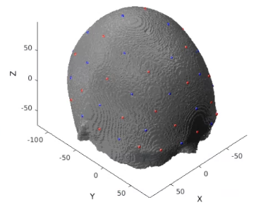
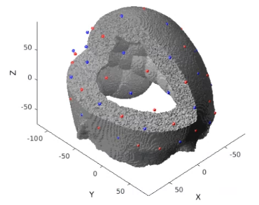
Calculate the sensitivity (1 of 3)
Prepare mesh and optode information for NIRFAST, then visualize
gridname=padname;
mesh=PrepareMeshForNIRFAST(mesh,[meshname,'_',gridname],tposNew);
PlotMeshSurface(mesh,pM);PlotSD(mesh.source.coord(1:Ns,:),...
mesh.source.coord((Ns+1):end,:),'render',gcf);
Visualize cap and mesh with portion cut out to make extra sure that optodes are not placed too far within the mesh
MRI Acquisition
Image Segmentation
Mesh Generation
For both LD and HD meshes
m3=CutMesh(mesh,intersect(find(mesh.nodes(:,3)>0),find(mesh.nodes(:,1)>0)));
[Ia,Ib]=ismember(m3.nodes,mesh.nodes,'rows');Ib(Ib==0)=[];
m3.region=mesh.region(Ib);
PlotMeshSurface(m3,pM);PlotSD(mesh.source.coord(1:Ns,:),...
mesh.source.coord((1+Ns):end,:),'render',gcf);
Optode Placement
Calculate Sensitivity
1.
2.

Slide 33
Calculate the sensitivity (2 of 3)
3. Set parameters for light modeling
flags.tag=[padname,'_on_',meshname,'_test'];
flags.gridname=gridname;
flags.meshname=meshname;
flags.head='info';
flags.info=infoT1; % Your T1 info file
flags.gthresh=1e-5; % Voxelation threshold in G
flags.voxmm=2; % Voxelation resolution (mm)
flags.labels.r1='csf'; % Regions for optical properties
flags.labels.r2='white';
flags.labels.r3='gray';
flags.labels.r4='bone';
flags.labels.r5='skin';
flags.op.lambda=[750,850]; % Wavelengths (nm)
flags.op.mua_skin=[0.0170,0.0190]; % Baseline absorption
flags.op.mua_bone=[0.0116,0.0139];
flags.op.mua_csf=[0.0040,0.0040];
flags.op.mua_gray=[0.0180,0.0192];
flags.op.mua_white=[0.0167,0.0208];
flags.op.musp_skin=[0.74,0.64]; % Baseline reduced scattering coeff
flags.op.musp_bone=[0.94,0.84];
flags.op.musp_csf=[0.3,0.3];
flags.op.musp_gray=[0.8359,0.6726];
flags.op.musp_white=[1.1908,1.0107];
flags.op.n_skin=[1.4,1.4]; % Index of refration
flags.op.n_bone=[1.4,1.4];
flags.op.n_csf=[1.4,1.4];
flags.op.n_gray=[1.4,1.4];
flags.op.n_white=[1.4,1.4];
flags.srcnum=Ns; % Number of sources
flags.t4=eye(4); % T1/dim to MNI atlas *** change this to register your vol to atlas
flags.t4_target='MNI'; % string
flags.makeA=1; % don't make A, just make G
flags.Hz=0;
if flags.Hz, flags.tag = [flags.tag,'FD']; end
MRI Acquisition
Image Segmentation
Mesh Generation
For both LD and HD meshes
Optode Placement
Calculate Sensitivity

Slide 34
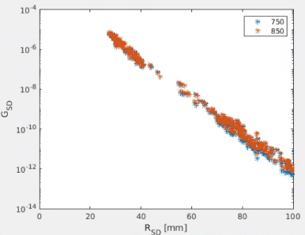
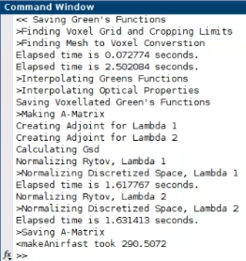
Calculate the sensitivity (3 of 3)
4. Calculate Green’s functions, voxelate, create sensitivity matrix, adjust bookkeeping
Ti=tic;[A,dim,Gsd]=makeAnirfaster(mesh,flags); % size(A)= [Nwl, Nmeas, Nvox]
disp(['<makeAnirfast took ',num2str(toc(Ti))])
%Gsd vs Rsd provides a simulated light fall-off figure;semilogy(info.pairs.r3d(1:(Ns*Nd)),Gsd,'*');
legend({num2str(flags.op.lambda')})
xlabel('R_S_D [mm]');ylabel('G_S_D');xlim([0,100])
If makeAnirfast is successful, info like the below screenshot should show up in your command window
MRI Acquisition
Image Segmentation
Mesh Generation
For both LD and HD meshes
Optode Placement
Calculate Sensitivity

Slide 35
Package Sensitivity Matrix with associated info
5. Arrange A to have the same measurement list structure as the data:
[Nwl,Nmeas,Nvox]=size(A);
A=reshape(permute(A,[2,1,3]),Nwl*Nmeas,Nvox);
6. Place spatial information about light model in infoHD.tissue structure:
infoHD.tissue.dim=dim;
infoHD.tissue.affine=flags.t4;
infoHD.tissue.infoT1=infoT1;
infoHD.tissue.affine_target='MNI';
infoHD.tissue.flags=flags;
temp_pairs=struct;
temp_pairs.Src=info.pairs.Src;
temp_pairs.Det=info.pairs.Det;
temp_pairs.NN=info.pairs.NN;
temp_pairs.WL=info.pairs.WL;
temp_pairs.lambda=info.pairs.lambda;
temp_pairs.Mod=info.pairs.Mod;
temp_pairs.r2d=info.pairs.r2d;
temp_pairs.r3d=info.pairs.r3d;
info.pairs=temp_pairs;
save(['A_',flags.tag,'.mat'],'A','infoHD','-v7.3') %save A
MRI Acquisition
Image Segmentation
Mesh Generation
For both LD and HD meshes
Optode Placement
Calculate Sensitivity

Slide 36
Package Sensitivity Matrix with associated info
6. Package and save A where all source-detector separations are less than 5cm
For sparse pads, only measurements from source-detector (SD) pairs that have a separation distance within 5cm are generally used. The Gsd vs Rsd scatterplot is a helpful tool for visualizing what measurements meet the 5cm cutoff. A red box has been placed around the measurements within the 5cm cutoff.
% Get A with all SD separations within 5cm
keep=info.pairs.r3d<=50;
temp=struct;
temp.Src=info.pairs.Src(keep);
temp.Det=info.pairs.Det(keep);
temp.NN=info.pairs.NN(keep);
temp.WL=info.pairs.WL(keep);
temp.lambda=info.pairs.lambda(keep);
temp.Mod=info.pairs.Mod(keep);
temp.r2d=info.pairs.r2d(keep);
temp.r3d=info.pairs.r3d(keep);
info.pairs=temp;
A=A(keep,:); %A with all SD within 5cm
save(['A_r3d_lth_50_',flags.tag,'.mat'],'A','info','-v7.3') %save A with all SD within 5cm
MRI Acquisition
Image Segmentation
Gsd vs Rsd
Mesh Generation
For both LD and HD meshes
Optode Placement
Calculate Sensitivity

Slide 37
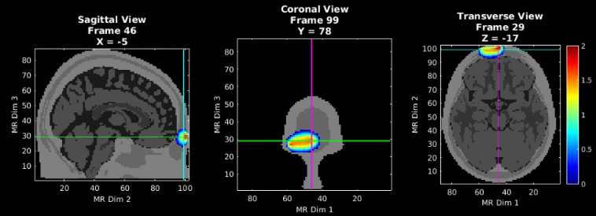
Validate the sensitivity (1 of 2)
Visualize an example measurement’s sensitivity
% Visualize aspects of sensitivity profile
t1=affine3d_img(mask,infoT1,dim,eye(4)); % put anatomical volume in dim space
keep=infoHD.pairs.WL==2 & infoHD.pairs.Src==1 & infoHD.pairs.Det==1;
foo=squeeze(A(keep,:)); % Single meas pair
fooV=Good_Vox2vol(foo',dim);
fooV=fooV./max(fooV(:));
fooV=log10(1e2.*fooV); % top 2 o.o.m.
pA.PD=1;pA.Scale=2;pA.Th.P=0;pA.Th.N=-pA.Th.P;
PlotSlices(t1,dim,pA,fooV)
MRI Acquisition
Image Segmentation
Mesh Generation
For both LD and HD meshes
Optode Placement
NN1: source 1 detector 6
Calculate Sensitivity
Validate Sensitivity

Slide 38
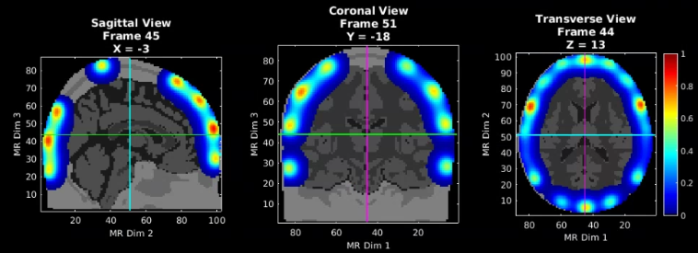
Validate the sensitivity (2 of 2)
Visualize the flat field reconstruction
keep=(infoHD.pairs.WL==2 & infoHD.pairs.r2d<=40);
a=squeeze(A(keep,:));
iA=Tikhonov_invert_Amat(a,0.01,0.1);
iA=smooth_Amat(iA,dim,5); % use smoothing parameter of 5 here
ffr=makeFlatFieldRecon(a,iA);
fooV=Good_Vox2vol(ffr,dim);
fooV=fooV./max(fooV(:));
pA.PD=1;pA.Scale=1;pA.Th.P=1e-2;pA.Th.N=-pA.Th.P;
PlotSlices(t1,dim,pA,fooV)
MRI Acquisition
Image Segmentation
Mesh Generation
For both LD and HD meshes
Optode Placement
Calculate Sensitivity
Validate Sensitivity

Slide 39
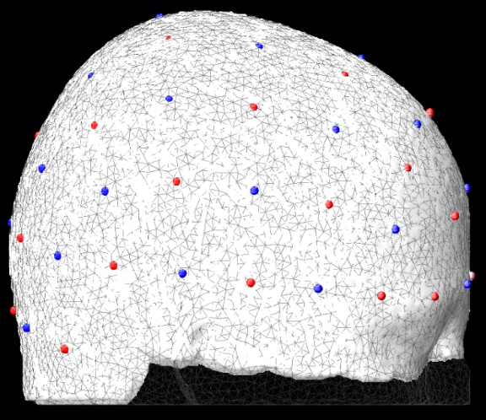
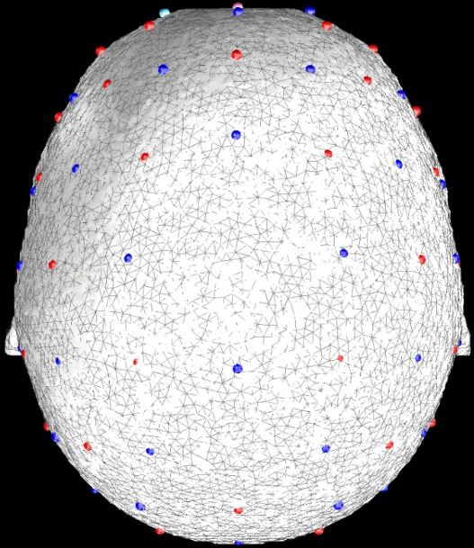
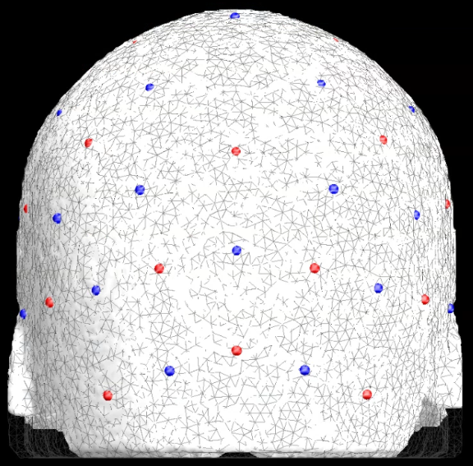
Put it all together
Lateral View
As a final check, let’s visualize the alignment of the LD mesh, HD mesh, optode array, and cortical meshes all together
% View alignment
Cortical_mesh = load(['MNI164k_big.mat']);
Anat.CtxL = Cortical_mesh.MNIl;
Anat.CtxR = Cortical_mesh.MNIr;
pA0l=struct;
figure('Color','k','Position',[500,100,1050,1000])
pM1.fig_handle=gca;pM1.FaceColor=[1,1,1].*0.5;
pM1.SpecularStrength=0.25;pM1.DiffuseStrength=0.5;
PlotMeshSurface(meshHD,pM1) % HD mesh
pA0l.fig_handle=gca;
pA0l.FaceColor=[1,1,1].*0.5;pA0l.EdgeColor='none';
pA0l.AmbientStrength=0.25;pA0l.DiffuseStrength=0.25;
pA0l.SpecularStrength=0.025;
PlotMeshSurface(Anat.CtxL,pA0l) % Cortical Surfaces
PlotMeshSurface(Anat.CtxR,pA0l)
pA2.fig_handle=gca;
pA2.FaceAlpha=0;
pA2.EdgeAlpha=0.5;
pA2.EdgeColor=[1,1,1].*0.25;
PlotMeshSurface(meshLD,pA2) % LD mesh
set(gca,'Color','k')
view([90,0]) % display in lateral view
Draw_Foci_191203(cat(1,info.optodes.spos3,info.optodes.dpos3),paramsFoci) % Array
axis off
% For posterior view uncomment the following line
% view([0,0])
% For dorsal view uncomment the following line
% view([0,90])
Dorsal View
Posterior View

Slide 40
Appendix: Generating info for Pad file (1 of 3)
The Pad file for a given grid design contains a structure variable info that contains the spatial and topological information for the array as follows:
info.optodes
Structure containing spatial coordinates for sources and detectors in array
info.optodes.spos2 – 2D coordinates of each sources
info.optodes.spos3 – 3D coordinates of each source
info.optodes.dpos2 – 2D coordinates of each detector
info.optodes.dpos3 – 3D coordinates of each detector
info.pairs
Table containing topological information for each source-detector measurement pair
Each row of this table corresponds to a measurement and must be in the same order as the optical data for valid processing
Generally, full list of sources and detectors is repeated for each wavelength/lambda.
info.pairs.Src – source in measurement
info.pairs.Det – detector in measurement
info.pairs.NN – Nearest Neighbor class in array (e.g., info.pairs.NN=1 means this measurement is one of the closest in the grid design)
info.pairs.WL – wavelength index of measurement
info.pairs.lambda – actual wavelength of measurement (e.g., info.pairs.lambda-=750 is a 750 nm measurement)
info.pairs.Mod – Modulation type of measurement (e.g., ‘CW’, or, ‘FD’)
info.pairs.r2d – 2D source-detector distances
info.pairs.r3d – 3D source-detector distances

Slide 41
Appendix: Generating info for Pad file (2 of 3)
If you already have a grid design with 2D and 3D source and detector locations, saved as the following:
grid.spos2
grid.spos3
grid.dpos2
grid.dpos3
To generate the topology structure for your grid:
dr=5; % Distance separating 'nearest neighbor' groups
Rad=Grid2Radius_180824(grid,dr);
Once you have the grid and radius set up (as above), the info structure can be generated with the following:
grid.name='Your_Grid_Name';
params.lambda=[750,850]; % Wavelengths for your system
params.Mod='CW'; % Modulation strategy
[info]=Generate_Info_from_Grid_Rad(grid,Rad,params);
Then just save the Pad file for future use:
save(['Pad_',info.optodes.CapName],'info')

Slide 42
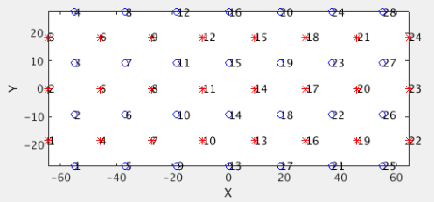
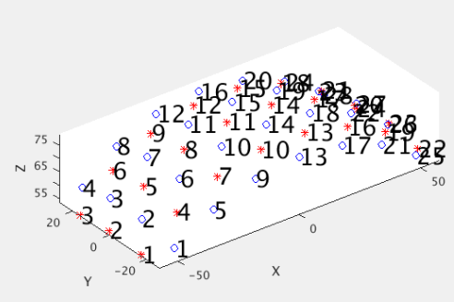
Appendix: Generating info for Pad file (3 of 3)
If instead you are designing a grid from scratch in style of our visual cap:
Ndy=4; % Num detectors in y-direction
Ndx=7; % Num detectors in x-direction
NN1sep=13; % Closest source-detector Separation
Srad=80; % Radius of spherical head model
[grid,Rad]=Make_Sphere_Cap(Ndy,Ndx,NN1sep,Srad);
As described above,
grid contains information on the positions of the sources and detectors.
Rad contains information on the topology of the array.
Visualize the grid in 2D and 3D
PlotSD(grid.spos2,grid.dpos2,'norm'); % Visualize 2D positions
PlotSD(grid.spos3,grid.dpos3,'norm'); % Visualize 3D positions
Then set parameters, generate info file as on previous slide, and save Pad file for future use.

Slide 43
That’s It (For Now)
Congratulations! You have finished the NeuroDOT Light Modeling Pipeline Tutorial for the 32x32 full head pad using AlignMe.
See other Sample Results Appendices for example visualizations of these same processing steps on the other Sample Data included in the toolbox.
Also, see the PreProcessing and Reconstruction tutorials to gain a deeper understanding of the effects of altering the processing parameters.
For further questions or more information, please consult the NeuroDOT User Manual and the various Appendices.
NeuroDOT Team:
Adam Eggebrecht (aeggebre@wustl.edu)
Emma Speh (espeh@wustl.edu)
Ari Segel (ari@wustl.edu)
Abby Magee (abigail.magee@wustl.edu)
Weihao Fan (weihao.f@wustl.edu)

